Slide 1


Advanced Arduino Concepts
Robotics Club

Slide 2
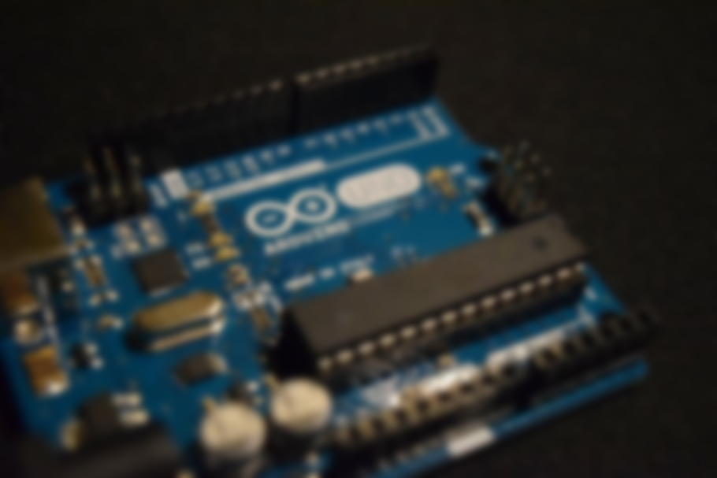
Outline
Arduino Recap
Sensors
Output Devices
Hands-on Demo
1
2
3
4

Slide 3

Recap:
What is
Arduino?

Slide 4
Open-source Electronics Platform
Microcontroller Board
Easy-to-use Hardware and Software
Overview

Slide 5
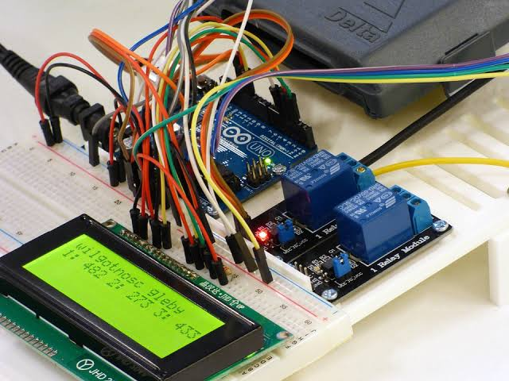

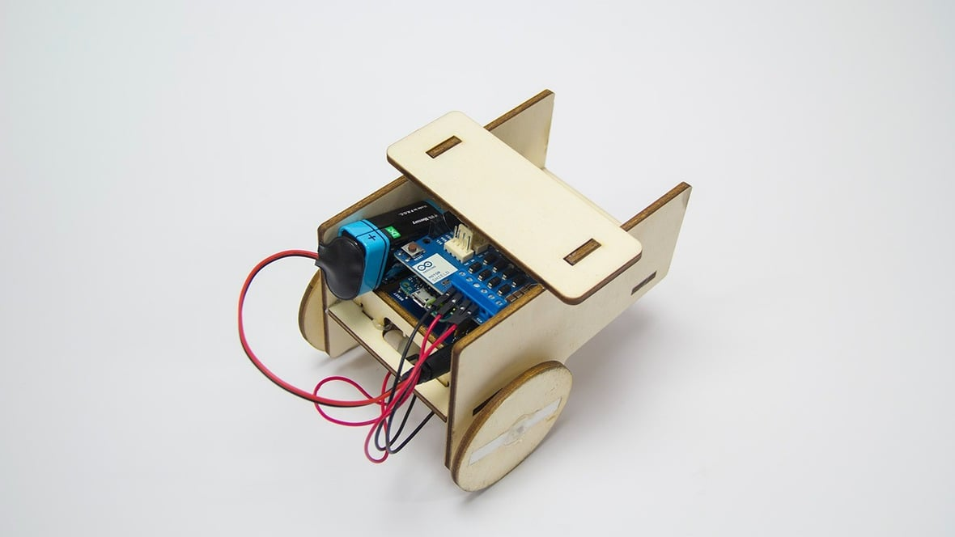
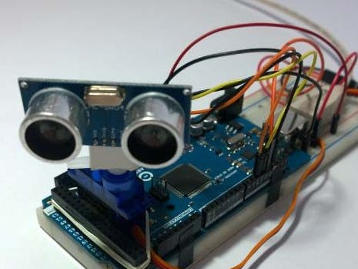
Arduino Capabilities
Control Physical Devices: Wide range of physical devices such as motors, lights, displays.
Collect and Process Data: Sensors such as temperature, distance, light, switches.
Communicate with Other Devices: Through Ethernet, Wi-Fi. Bluetooth, etc.
Robot Arms
Scientific Experiments
Home Automation
Games
Rovers
Internet of Things
Wearables

Slide 6
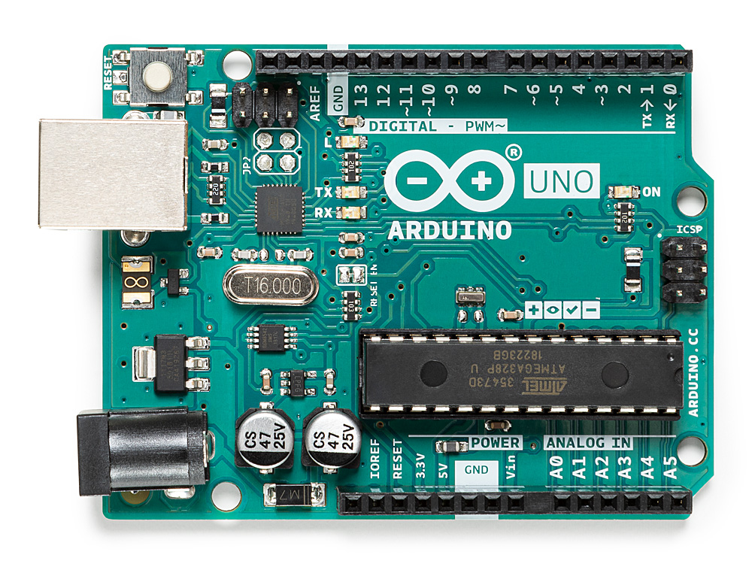
Components
Digital Pins
(High, Low)
Serial Pins
(Communication)
Power In
+ Sketch Upload
Analog Pins
(Numerical Values)
Power Out
(3.3V, 5V)
Ground

Slide 7
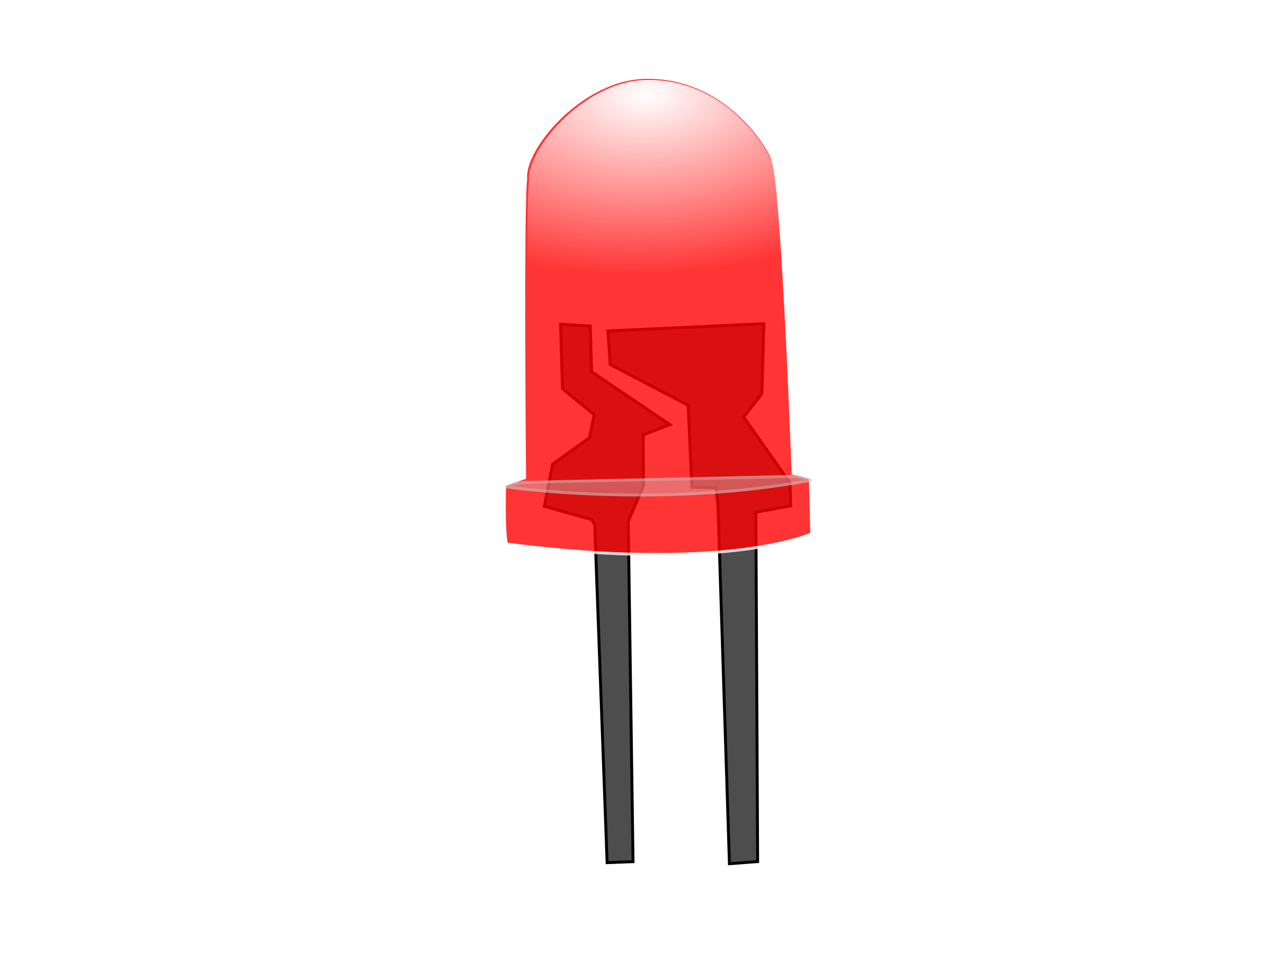

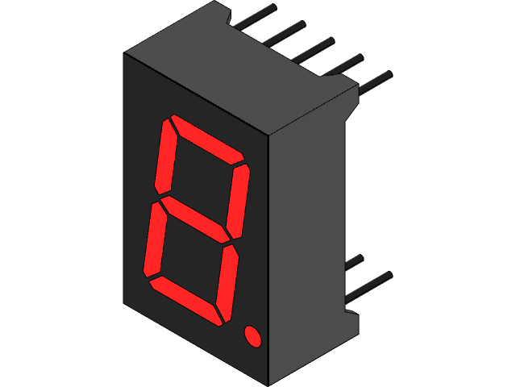
Components
Actuators
Sensors
Displays
LEDs
Motors: Servo, Stepper, …
Relays
Buzzers
Ultrasonic Sensor
Infrared Sensor
Temperature Sensor
Light Sensor
7-segment Display
LCD Display
Matrix Display

Slide 8
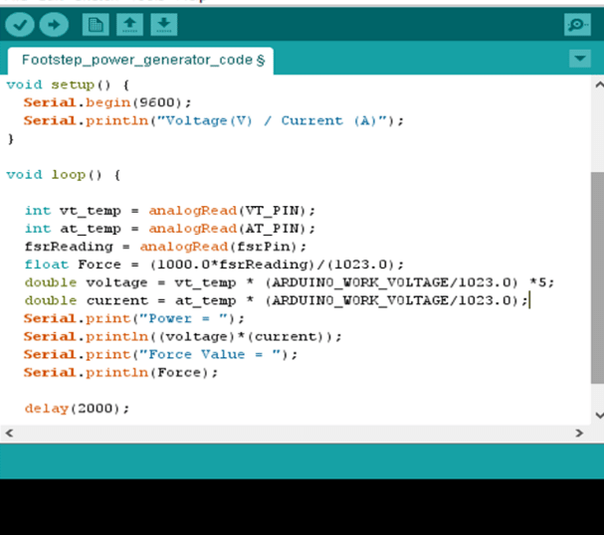
Arduino Code
Arduino code is written in a file called a Sketch, using a variant of the C++ language.
The structure of the code will consist of:
Setup Function:
Runs once at the beginning of the program.
Initializes pins & variables and sets up motors/sensors.
Loop Function: Program logic that will execute in a constant loop.
Variables: Store data such as numbers or text and reuse it in the code.
Functions: Set of instructions that will perform a task.

Slide 9
Arduino
Sensors

Slide 10
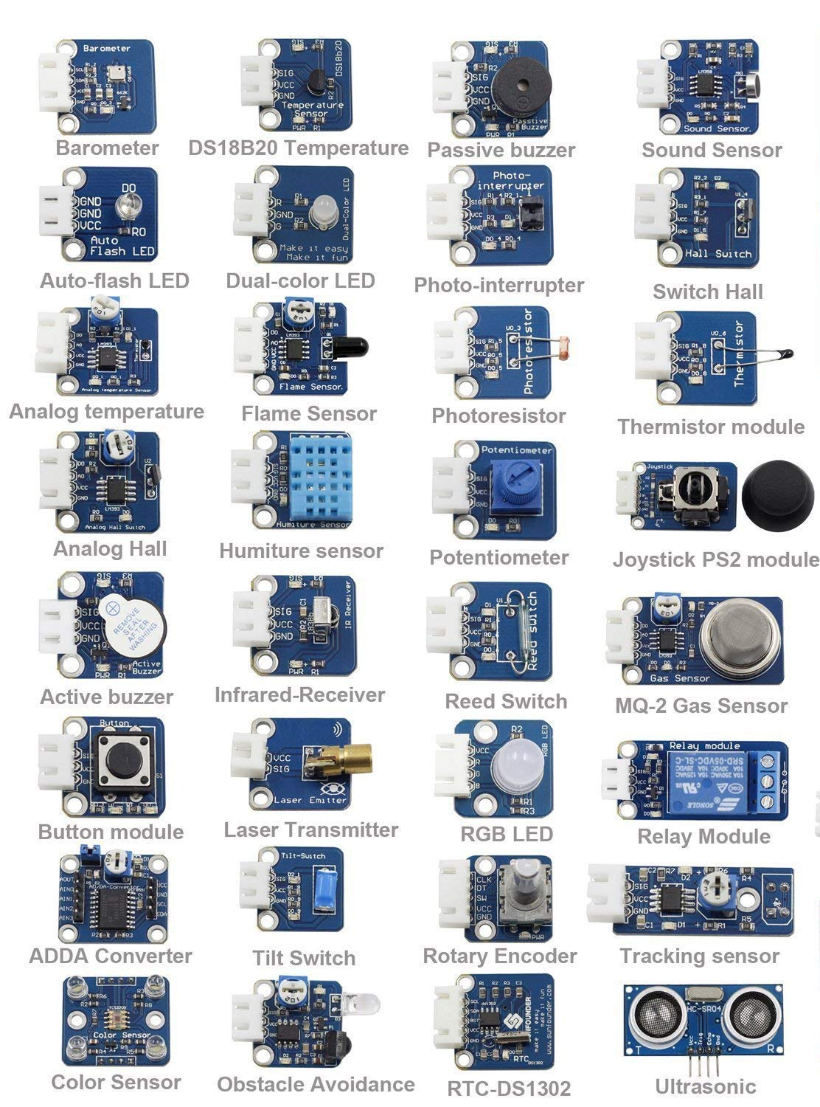
Sensors: Analog Data
Sensors provide a continuous range of values that can be read through analog input pins. ≠ Digital pins (1s and 0s)
Convert physical data (temperature or light) into electrical signals (voltage or current).
On the Arduino, sensors are connected to the analog pins labeled A0 to A5.
Types of Sensors:
Ultrasonic Sensor
Potentiometer
Joystick
Light Sensor

Slide 11
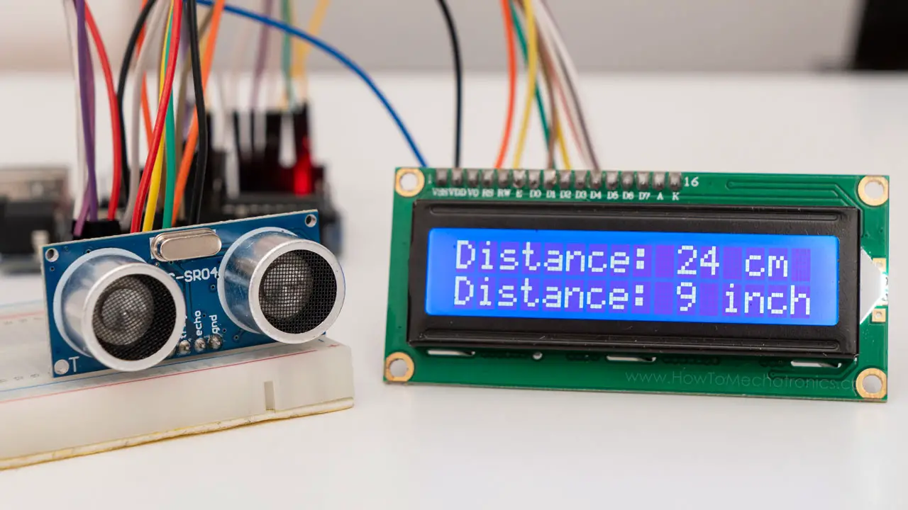
Sensors: Ultrasonic Sensor
The Ultrasonic Sensor uses sound waves to measure distance between the sensor and any object.
How does it work?
Emits a high-frequency sound wave which bounces of objects.
Receives the same sound wave.
Measures the time between sending and receiving the wave.
Calculates the distance based on the time taken and the speed of sound.
Use Cases:
Obstacle Detection
Security Systems
Parking Sensors

Slide 12
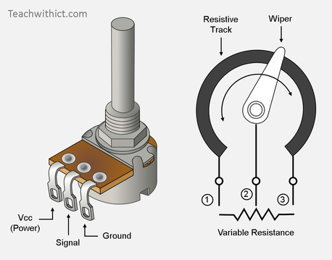
Sensors: Potentiometer
The Potentiometer is a variable resistor whose resistance can be adjusted by turning its knob.
It is made up of three terminals:
First and second are fixed and connected to Vcc and ground.
Middle terminal is connected to a movable slidable contact.
Turning the knob moves the contact changing the resistance.
Potentiometers have a maximum range indicated on them.
Use Cases:
Controlling volume of audio signals
Adjusting brightness
Changing the speed of a motor

Slide 13
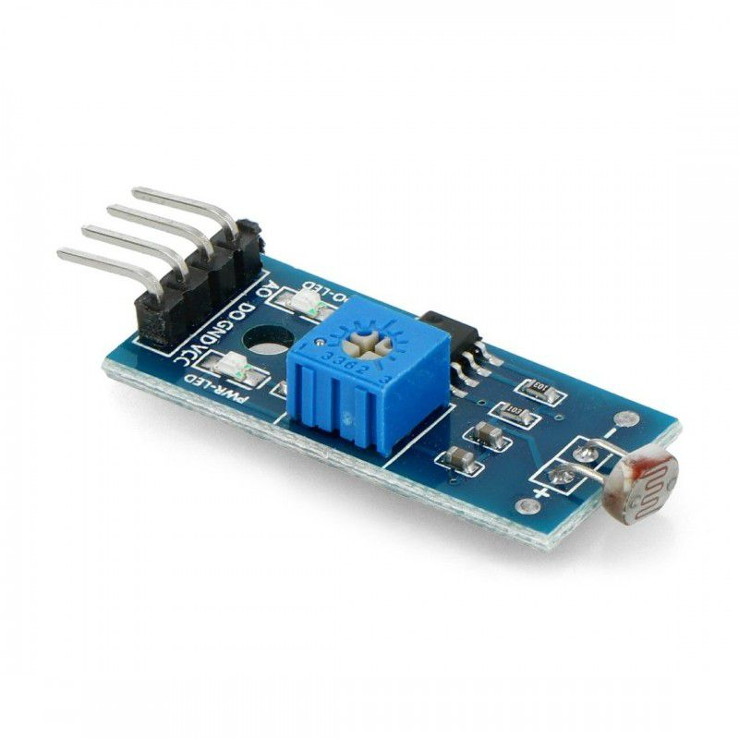
Sensors: Light Sensor
The Light Sensor, also known as photoresistor, measures the amount of light surrounding it.
It is a type of resistor whose resistance decreases proportional to the light intensity.
Made up of chemical materials that respond to changes in light levels.
Use Cases:
Camera exposure control
Automatic Lighting Control
Smart Agriculture

Slide 14
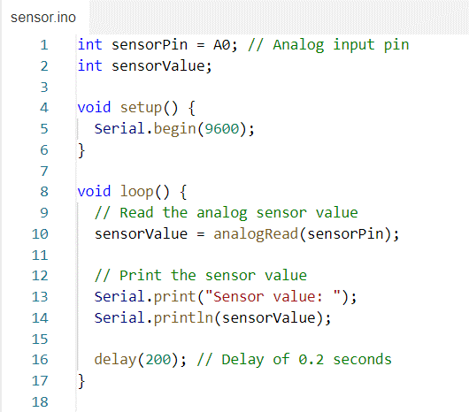
Sensors: Generic Code
The code details vary from one sensor to another.
The concept is the same:
Read analog data from the sensor.
Perform necessary calculations.
Display the sensor value or use it to control output devices.

Slide 15
Arduino
Output Devices

Slide 16

Output Devices: Servo motor
The Servo Motor is a type of motor used to precisely control the position of its output shaft.
Can rotate to a specific angle and hold that position until a new one is requested.
Internally, the servo motor includes control circuits that monitor its position and allow it to adjust its speed to maintain this position.
Servo motors can also be instructed to rotate continuously until instructed to stop.
Use Cases:
Robotic Arms
Cutting Machines
Camera Control

Slide 17
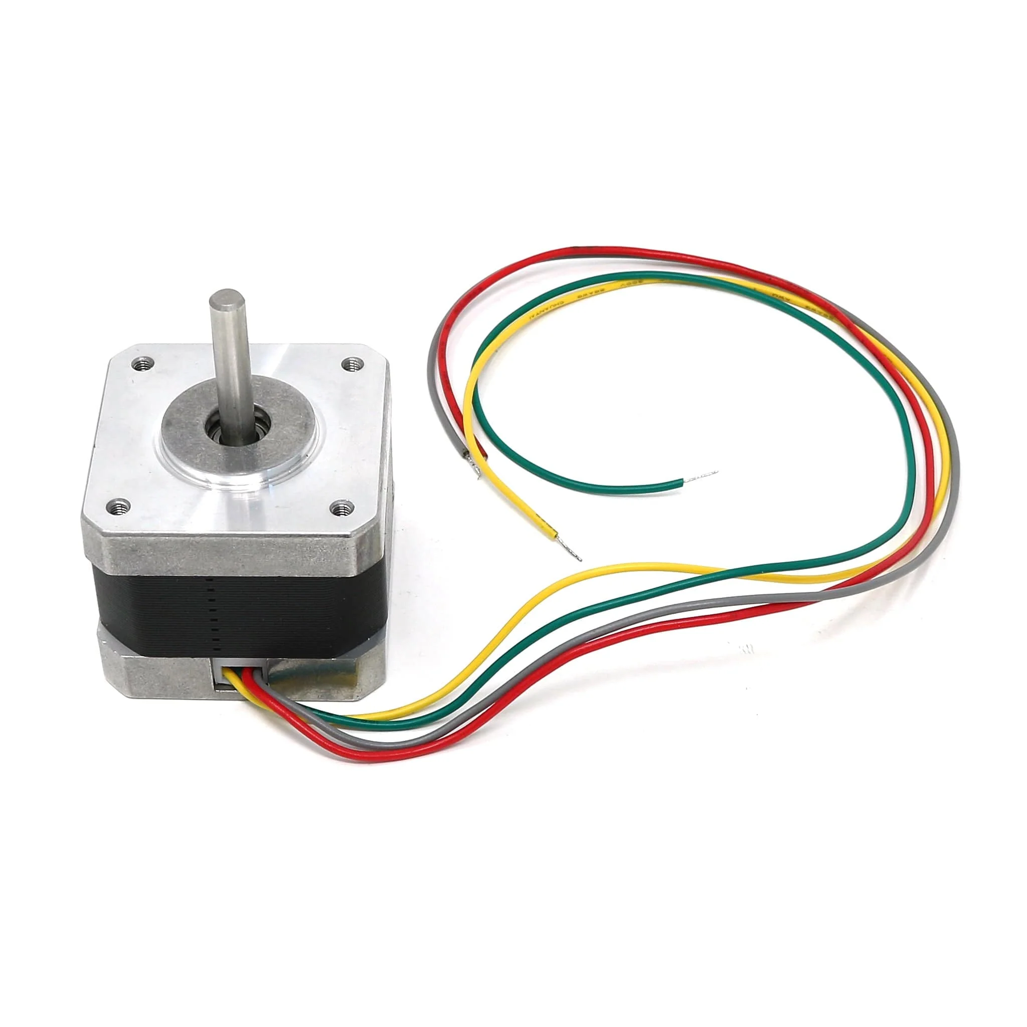
Output Devices: Stepper motor
The Stepper Motor is a type of motor that rotates in small, precise steps instead of continuously.
The full rotation of the motor is divided into steps or angles.
In general, not designed to rotate continuously unlike the servo motor, but is more accurate in small steps.
Use Cases:
Robotic Arms
Printers or Scanners
Medical Pumps

Slide 18
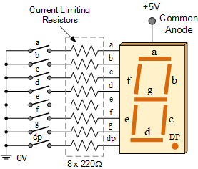
Output Devices: 7-segment display
The 7-segment display is a display device used to convey numeric digits and some letters or symbols.
Consists of seven segments that can be individually controlled.
The segments are labeled A to G, and the patterns of the displayed symbols or numbers will depend on which segments are turned on or off.
Use Cases:
Digital Clocks
Counters
Scoreboards

Slide 19
Hands-on
Demo

Slide 20
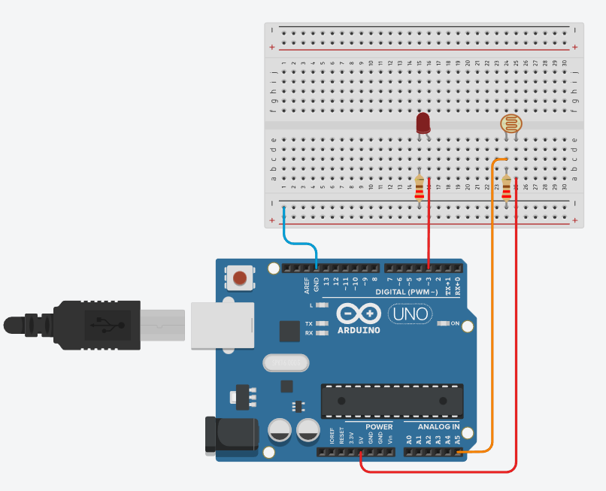
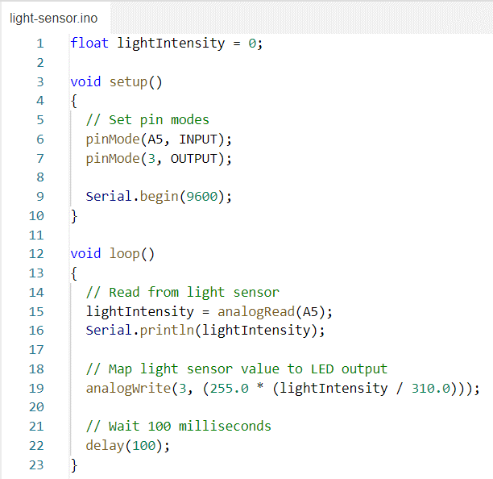
Example 1: Light Sensor

Slide 21
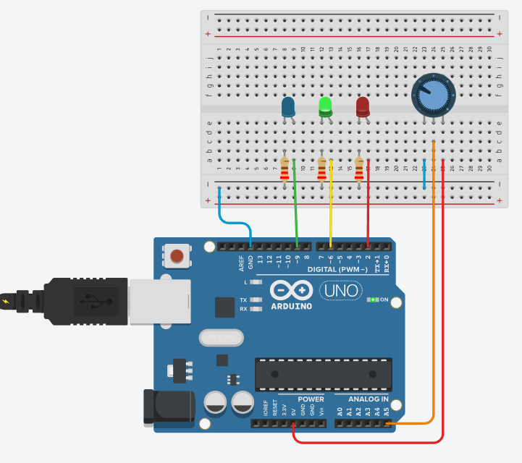
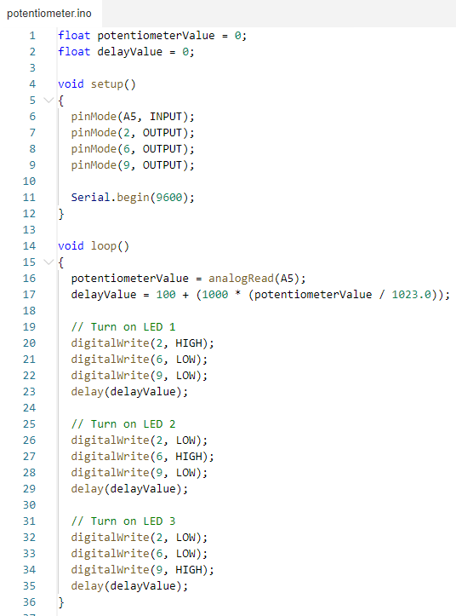
Example 2: Potentiometer

Slide 22
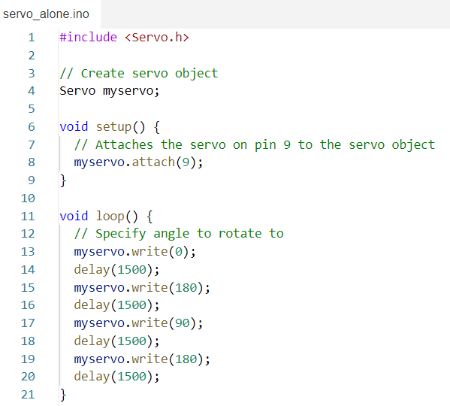
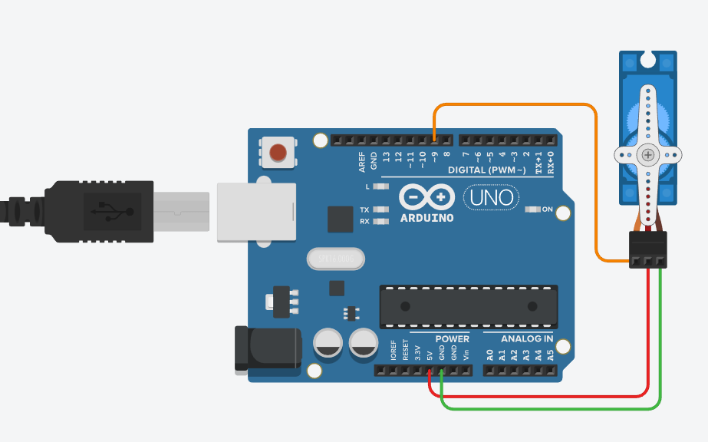
Example 3: Servo Motor

Slide 23
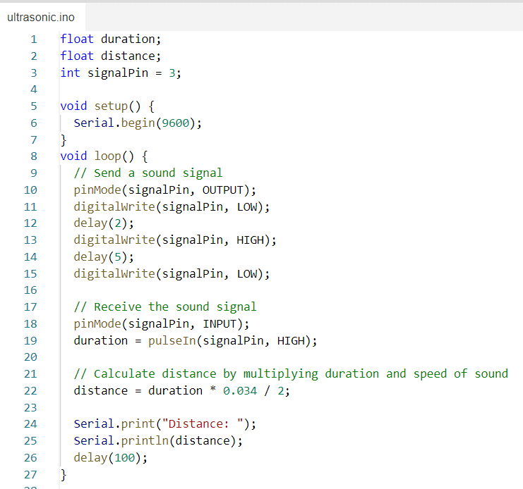
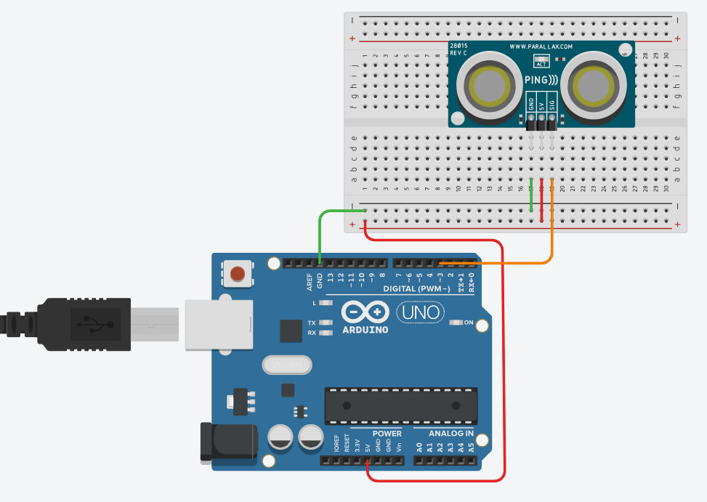
Example 4: Ultrasonic Sensor

Slide 24
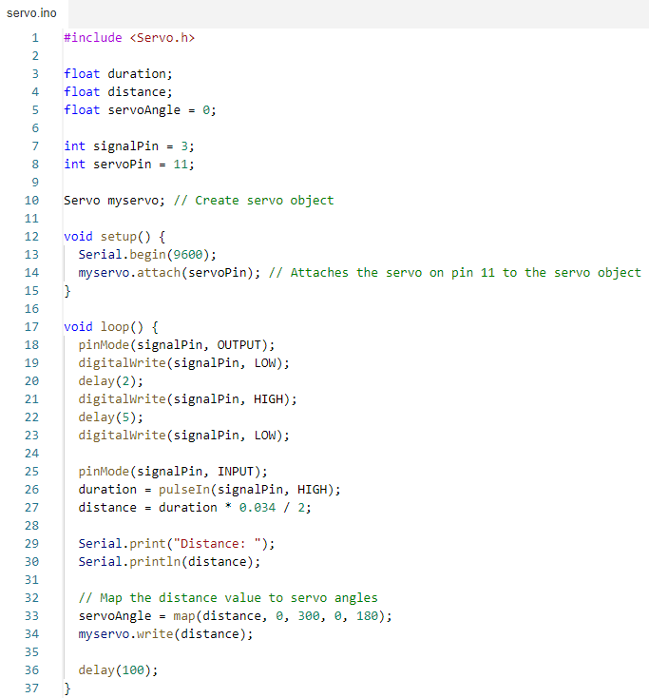
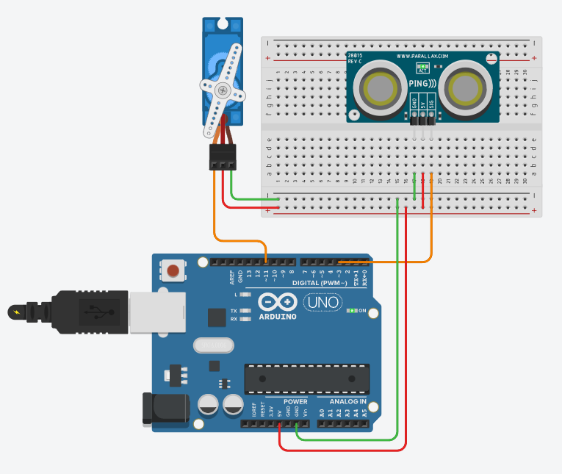
Example 5: Servo Motor with Ultrasonic Sensor

Slide 25
Thank you!
Robotics Club

